Slide 1
LMI INTEGRATED FORMATION AND EDUCATION, INC.
Lakandula St., Poblacion, Mariveles, Bataan
PRACTICAL RESEARCH 2
QUANTITATIVE APPROACH
TITLE PROPOSAL
YEONG, SEAN MATHEW D.
MENDOZA, CLARENZ GLEN M.
GLIANE, MICO JAMES D.
Student Researchers, 12 ICT-SAGITTARIUS
Notes:
0

Slide 2
Factors Affecting Communication with Research Participants Among Grade 12 Students in Practical Research 1 at LIFE Institute Mariveles
BorcellE UNIVERSITY
HOME
ABOUT
RESULT
CONCLUSION
The main goal of this study is to determine the factors that affect communication between Grade 12 student-researchers and their research participants in Practical Research 1at LIFE Institute Mariveles. Specifically, the study seeks to examine how the informed consent process, the mode of communication used, participant availability and responsiveness, and the student-researcher's own confidence or comfort level influence the clarity, honesty, and overall quality of communication during data collection.
Notes:
MAIN IDEA
The study focuses on the factors that affect how Grade 12 students communicate with research participants while conducting research in Practical Research 1.
RESEARCH PROBLEM
Some students may experience difficulties when communicating with research participants, such as difficulty approaching participants, lack of confidence, unclear communication, limited cooperation, or difficulty getting responses.
RESPONDENTS
The respondents are Grade 12 students taking Practical Research 1 at LIFE Institute Mariveles.
WHY GRADE 12?
Grade 12 students are appropriate because they are directly involved in research activities and have experience communicating with research participants

Slide 3
Independent Variable | Dependent Variable
Mode/channel of communication (face-to-face, online, message-based) | Clarity and completeness of information exchanged
Informed consent process | Participant comfort and trust
Student-researcher's communication skills and confidence | Willingness of participants to disclose information
Participant availability | Frequency of participant response
Notes:
Independent Variable:
Factors affecting communication
Possible factors:
- Confidence
- Communication skills
- Participant cooperation
- Availability of participants
- Clarity of questions/instructions
- Difficulty approaching participants
Dependent Variable:
- Communication with research participants
RESEARCH DESIGN
Quantitative research because the study will collect numerical data through a structured questionnaire and summarize the responses statistically.

Slide 4
BorcellE UNIVERSITY
Gelinas et al. (2021) examine online communication as an important but risky channel for interacting with clinical research participants. The authors note that most existing discussions focus on mitigating these risks, with little attention paid to the genuine benefits online communication offers participants. They present a taxonomy of these benefits and argue against simply restricting online communication, proposing instead a context-sensitive approach built on participant education. This is relevant here because it reframes communication as a channel with real value that student-researchers should use thoughtfully, which is useful for examining the benefits and difficulties Grade 12 researchers report when communicating with participants online.
HOME
ABOUT
RESULT
CONCLUSION

Slide 5
BorcellE UNIVERSITY
Eeckhout et al. (2022) examined the communication barriers research staff face when explaining research participation to potential participants, using semi-structured interviews with thirteen research staff at a university hospital. The findings showed that both communication-related and process-related factors affect the informed consent process, leading the researchers to recommend communication training, more interactive materials, and digital alternatives. This is relevant because it shows that the quality of communication, not just the information conveyed, determines how well participants understand and engage with a study, mirroring the challenges Grade 12 researchers may face when explaining their own research.
HOME
ABOUT
RESULT
CONCLUSION

Slide 6
Namey et al. (2021) conducted a quasi-experimental study on medical risk during pregnancy, comparing focus groups and individual interviews conducted in-person, through online video, through synchronous online chat, and through asynchronous online message boards, with 171 participants assigned across the four formats. Disclosure of sensitive information did not differ significantly between the formats, but chat and message board focus groups surfaced more disagreement than in-person and video groups, and participants in the video focus groups felt notably less at ease and connected than those in the other formats. This supports the idea that the channel through which student-researchers communicate with participants can shape both the quality and comfort of the information gathered, which is directly relevant to how student-researchers here choose between face-to-face, chat, or online communication with their own respondents.
BorcellE UNIVERSITY
HOME
ABOUT
RESULT
CONCLUSION

Slide 7
Summary of Preliminary Survey Results
BorcellE UNIVERSITY
HOME
ABOUT
RESULT
CONCLUSION
Demographics
Grade 12 Strand and Section
12-ABM Pisces: 13 (28.3%)
12-STEM Taurus: 11 (23.9%)
12-HUMSS Sagittarius: 11 (23.9%)
12-STEM Virgo: 9 (19.6%)
12-ICT Sagittarius: 2 (4.3%)
Total Number of Students: 46
Notes:
DATA COLLECTION
A close-ended questionnaire can be used to measure the factors experienced by the respondents.
PURPOSE
The purpose is to identify which factors affect students' communication with research participants and understand the common communication difficulties they experience.
IMPORTANCE
The findings may help students and teachers identify communication difficulties during research and develop strategies to improve communication with research participants.

Slide 8
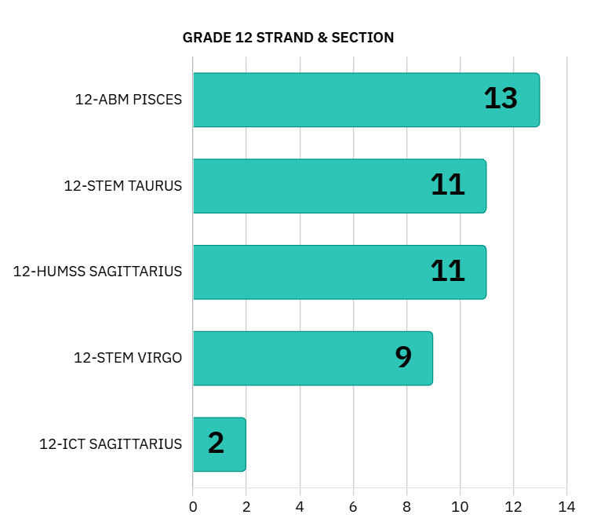

Slide 9
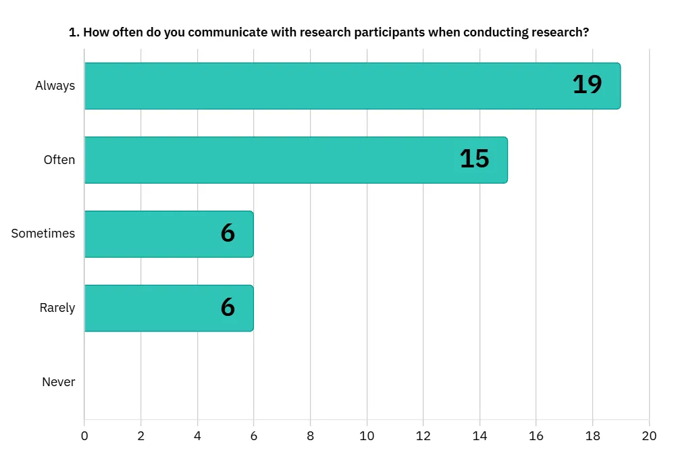

Slide 10
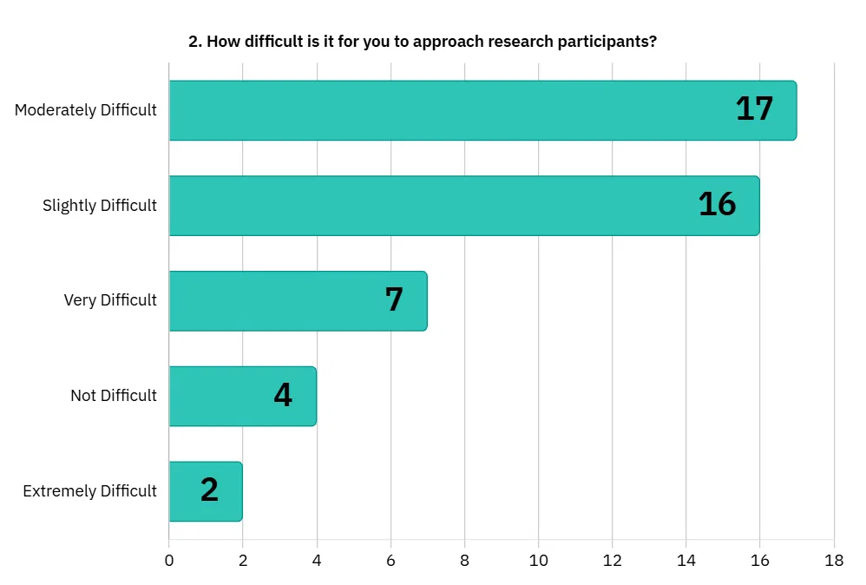

Slide 11
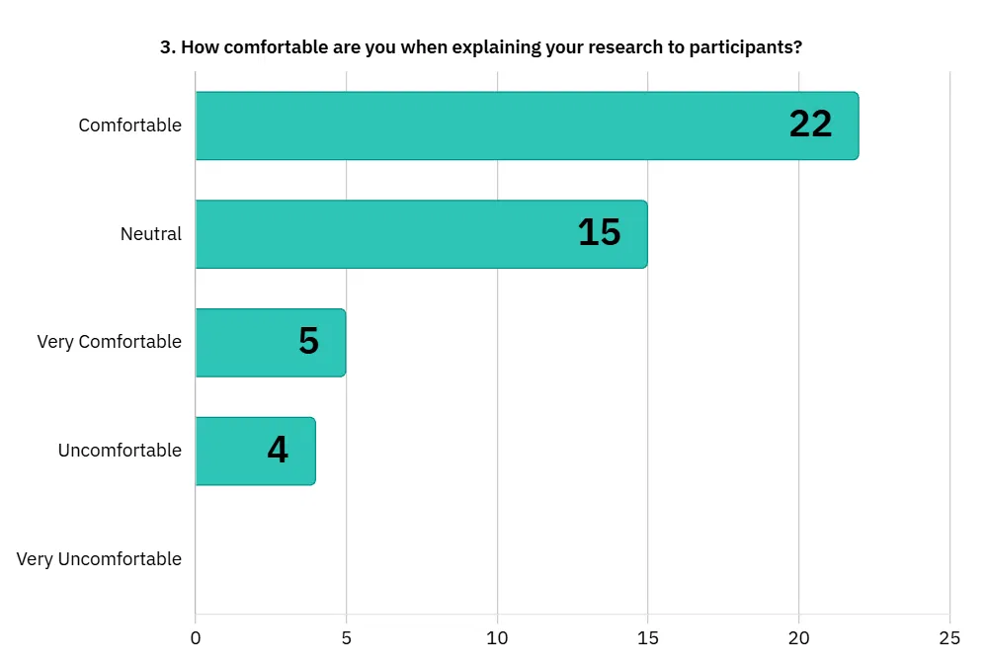

Slide 12
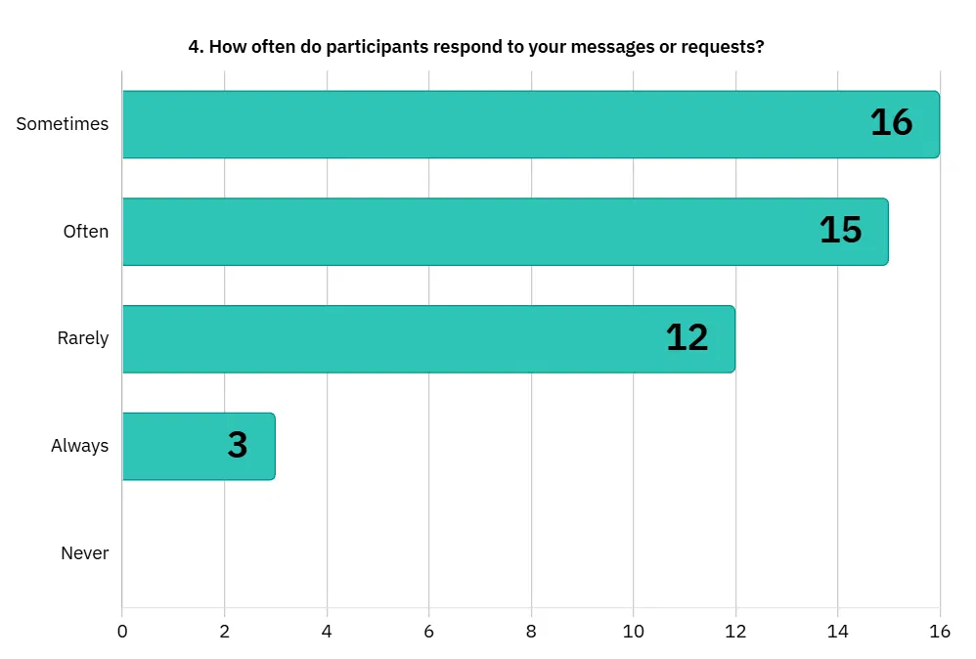

Slide 13
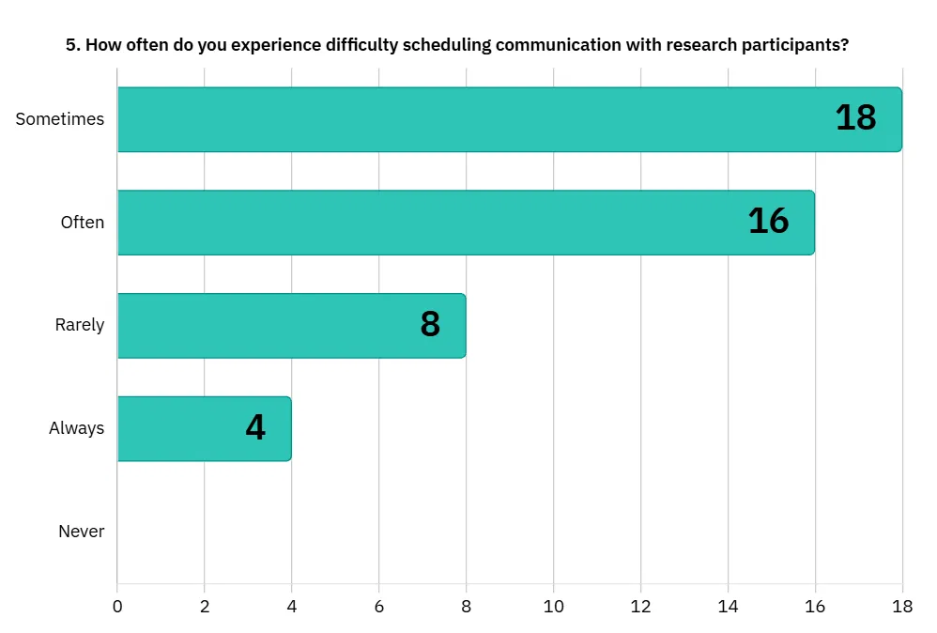

Slide 14
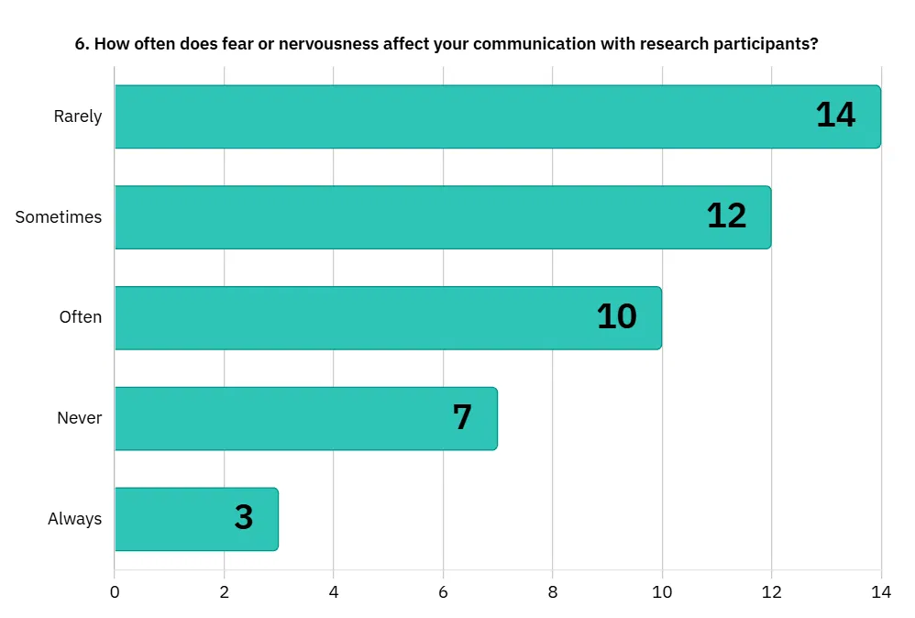

Slide 15
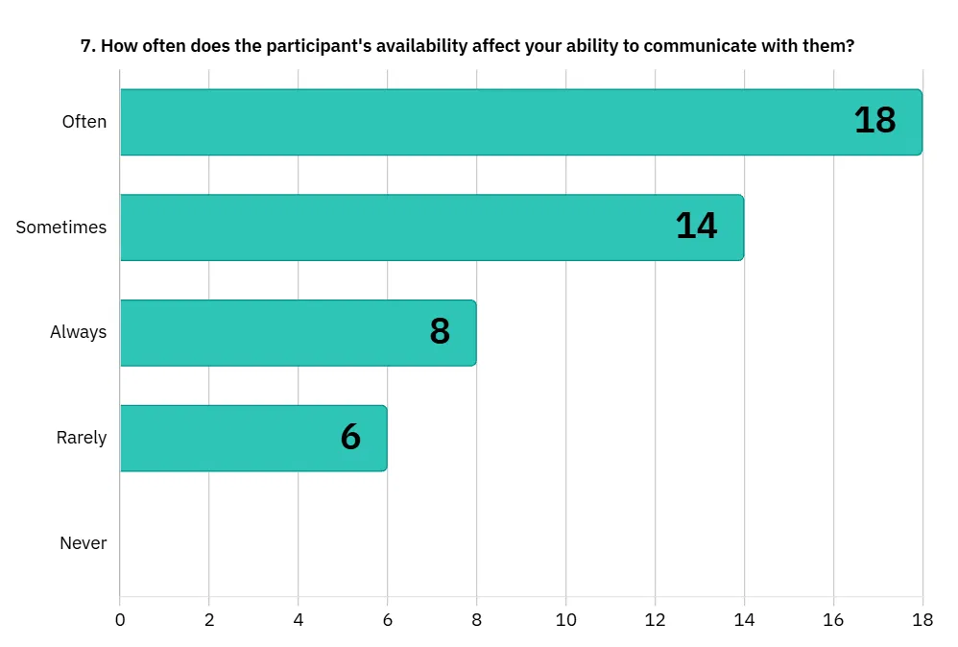

Slide 16
Summary of Preliminary Survey Results
BorcellE UNIVERSITY
HOME
ABOUT
RESULT
CONCLUSION
Based on the forty-six Grade 12 respondents from LIFE Institute Mariveles, the findings indicate that most students communicate with research participants often or always and feel comfortable explaining their research. Most respondents also reported that fear or nervousness affects their communication only rarely or sometimes.

Slide 17
Summary of Preliminary Survey Results
BorcellE UNIVERSITY
HOME
ABOUT
RESULT
CONCLUSION
However, the results also show that approaching participants is difficult for nearly all respondents, and participants do not consistently respond to messages or requests. Scheduling communication and participant availability were reported as frequent barriers. Since the preliminary survey covered only selected factors, other factors not included may also affect communication with research participants. These findings provide an initial basis for further examining the factors affecting communication with research participants among Grade 12 students.

Slide 18
REFERENCES:
BorcellE UNIVERSITY
HOME
ABOUT
RESULT
CONCLUSION
Eeckhout, D., Aelbrecht, K., & Van Der Straeten, C. (2022). Informed consent: Research staff's perspectives and practical recommendations to improve research staff-participant communication. Journal of Empirical Research on Human Research Ethics, 18(1–2), 3–12. https://doi.org/10.1177/15562646221146043
Gelinas, L., Morrell, W., White, S. A., & Bierer, B. E. (2021). Online research participant communication: Balancing benefits and risks. Ethics & Human Research, 43(4), 2–10.
https://doi.org/10.1002/eahr.500094
Namey, E., Guest, G., O'Regan, A., Godwin, C. L., Taylor, J., & Martinez, A. (2021). How does qualitative data collection modality affect disclosure of sensitive information and participant experience? Findings from a quasi- experimental study. Quality & Quantity, 56, 2341–2360. https://doi.org/10.1007/s11135-021-01217-4

